Slide 1
LinUx
Tools: Vmware (Virtual Machine)
Linux OS: Ubuntu

Slide 2
Just like windows XP, windows 7, windows 8, and mac OS X, Linux is an operating system. an operating system is software that manages all of the hardware resources associated with your desktop or laptop. to put it simply – the operating system manages the communication between your software and your hardware. without the operating system (often referred to as the “OS”), the software wouldn’t function.
What is Linux?

Slide 3
1. The boot loader: the software that manages the boot process of your computer. for most users, this will simply be a splash screen that pops up and eventually goes away to boot into the operating system. The kernel: this is the one piece of the whole that is actually called “linux”. the kernel is the core of the system and manages the cpu, memory, and peripheral devices. The kernel is the “lowest” level of the os. 2. Daemons: these are background services (printing, sound, scheduling, etc) that either start up during boot, or after you log into the desktop. 3. The shell: you’ve probably heard mention of the linux command line. this is the shell – a command process that allows you to control the computer via commands typed into a text interface. this is what, at one time, scared people away from linux the most (assuming they had to learn a seemingly archaic command line structure to make linux work). this is no longer the case. with modern desktop linux, there is no need to ever touch the command line.
The OS is comprised of a number of pieces:
4. Graphical Server: This is the sub-system that displays the graphics on your monitor. It is commonly referred to as the X server or just “X”.
5. Desktop Environment: This is the piece of the puzzle that the users actually interact with. There are many desktop environments to choose from (Unity, GNOME, Cinnamon, Enlightenment, KDE, XFCE, etc). Each desktop environment includes built-in applications (such as file managers, configuration tools, web browsers, games, etc).
6. Applications: Desktop environments do not offer the full array of apps. Just like Windows and Mac, Linux offers thousands upon thousands of high-quality software titles that can be easily found and installed. Most modern Linux distributions (more on this in a moment) include App Store-like tools that centralize and simplify application installation. For example: Ubuntu Linux has the Ubuntu Software Center (Figure 1) which allows you to quickly search among the thousands of apps and install them from one centralized location.

Slide 4
Benefit of Linux
10. Troubleshoot Other Computers
9. Make a Chromebook More Useful
8. Host a Web Site or Webapp
7. Work with Hard Drives and Partitions
6. Automate Everything In Your Home
5. Run a Home Server for Backup, Streaming, Torrenting, and More
4. Create a Dedicated Media Center or Video Game Machine
3. Brush Up on Your Hacking and Security
2. Revive an Old or Slow PC
1. Learn More About How Computers Work
https://www.quora.com/What-are-the-benefits-of-learning-how-to-use-Linux#

Slide 5
Introduction of this Tutorial
Basic Command
Shell Scripting
File Permission
Setup and Connect to SSH
User Account Management
Process File System Monitoring
Command helpers

Slide 6

Shell/Terminal/Command Interface
Username
My home directory
Host

Slide 7
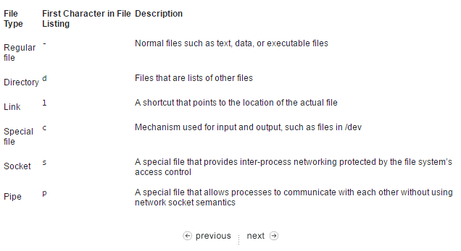
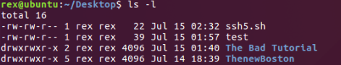
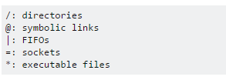
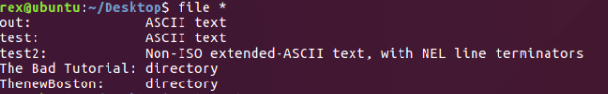
Linux File type
file [ -bchikLnNprsvz ] [ -f namefile ] [ -F separator ] [ -m magicfiles ] file ... file -C [ -m magicfile ]
Function- determine file type
File * : will display all files and its types in current directory

Slide 8
Basic Command

Slide 9
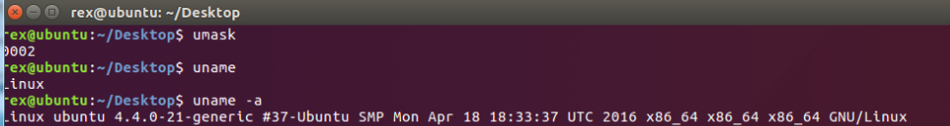
Basic Command
uname
SYNOPSIS
uname
Function: shows important information about your system such as kernel name, host name, kernel release number, processor type and various others. You can use uname -a to view all information.
http://www.computerhope.com/unix/uuname.htm

Slide 10
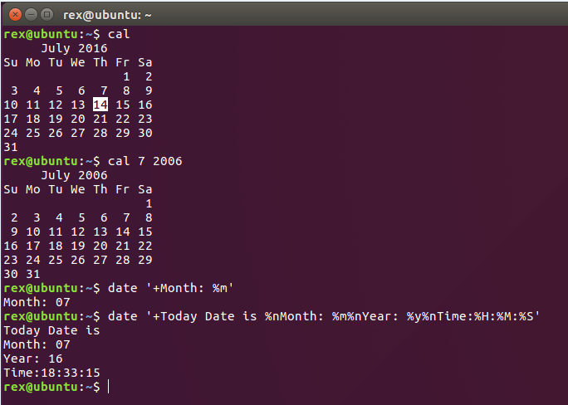
Basic Command
Cal and date
SYNOPSIS
cal [-mjy] [[month] year]
Function: To display a calendar
date - To display or change the date.
http://www.computerhope.com/unix/udate.htm
http://www.computerhope.com/unix/ucal.htm

Slide 11

Basic Command
pwd
pwd – Print Working Directory
SYNOPSIS
pwd
Function: Print the full filename of the current working directory.
http://www.computerhope.com/unix/upwd.htm

Slide 12
Basic Command
ls
ls – List
SYNOPSIS
ls
Function: List information about the Files (current directory by default).
ls [FILE]...
http://www.computerhope.com/unix/uls.htm

Slide 13
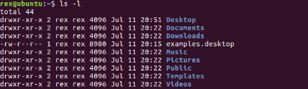
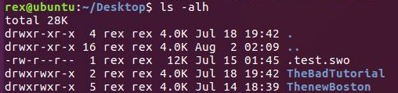
Basic Command
ls [OPTION]...[FILE]...
-l: use long list format
-h: print size
-a: do not ignore entries starting with . (show hidden files)
Combine Options
http://www.computerhope.com/unix/uls.htm
Type man ls for more info

Slide 14
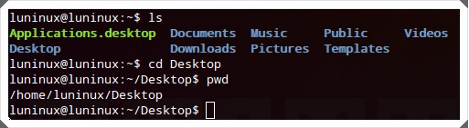
Basic Command
cd
cd – Change Directory
SYNOPSIS
cd <directory>
Function: change the current working directory to a specific Folder
http://www.computerhope.com/unix/ucd.htm

Slide 15
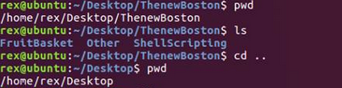

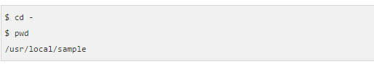
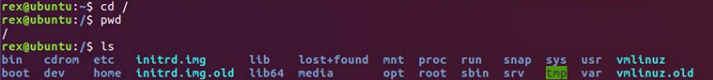
Basic Command
cd [Options]
Cd .. : Move up one Folder
Cd ~ & Cd : Change directory to user default directory
Cd - : Quickly get back & print current directory
Cd / : Change directory to machine default directory
http://www.computerhope.com/unix/ucd.htm
Type man ls for more info

Slide 16
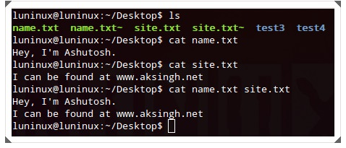
Basic Command
cat
cat
SYNOPSIS
cat <file>
Function: concatenates and prints files on the standard output (i.e., the monitor or computer’s screen). It’s the same as you viewing contents of text files using text viewer or editor in GUI.
http://www.computerhope.com/unix/ucat.htm

Slide 17
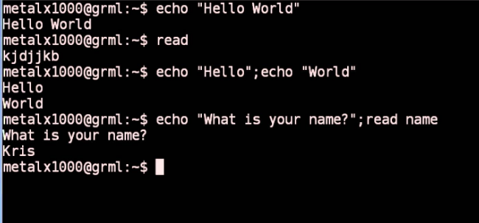
Basic Command
echo
cat
SYNOPSIS
echo [OPTION]... [STRING]...
Function: display a line of text
http://www.computerhope.com/unix/uecho.htm

Slide 18
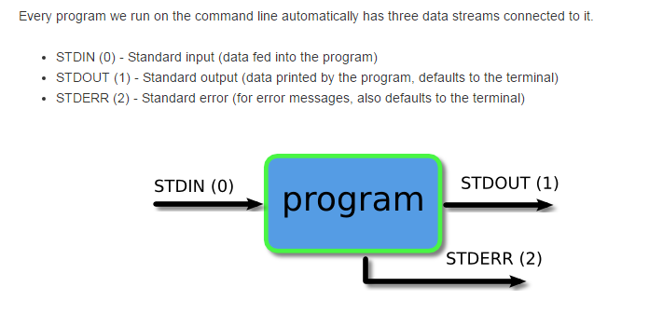
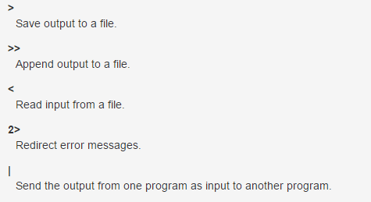
Redirection
Basic Command
Type man ls for more info

Slide 19

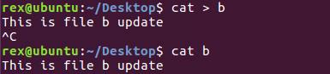
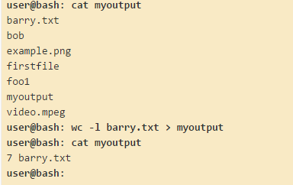
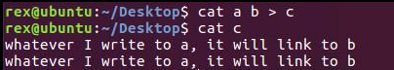
Basic Command
>
[option] [filename] > [filename] : save output to a file (Overwrite it).
[option] [filename] [filename] > [filename] : save multi file output to a file (Overwrite it).
Type man ls for more info

Slide 20

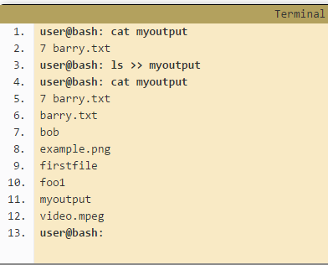
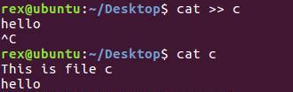
Basic Command
>>
[option] [filename] >> [filename] : append output to a file without overwrite it.
Type man ls for more info

Slide 21
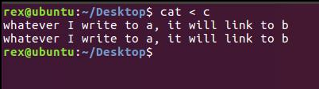
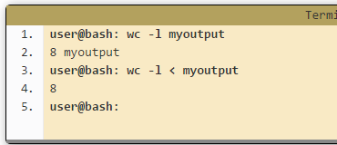
Basic Command
<
[option] < [filename] : read input from a file.
Type man ls for more info

Slide 22
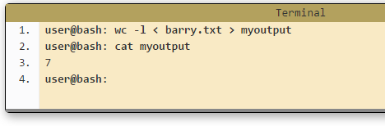
Basic Command
< and >
Type man ls for more info

Slide 23
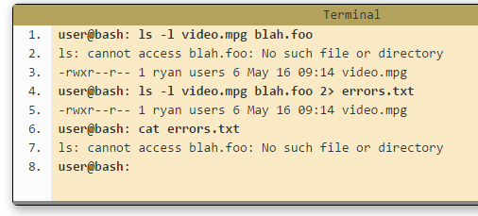
Basic Command
2>
Now let's look at the third stream which is Standard Error or STDERR. The three streams actually have numbers associated with them (in brackets in the list at the top of the page). STDERR is stream number 2 and we may use these numbers to identify the streams. If we place a number before the > operator then it will redirect that stream (if we don't use a number, like we have been doing so far, then it defaults to stream 1).
Type man ls for more info

Slide 24
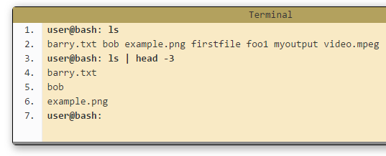
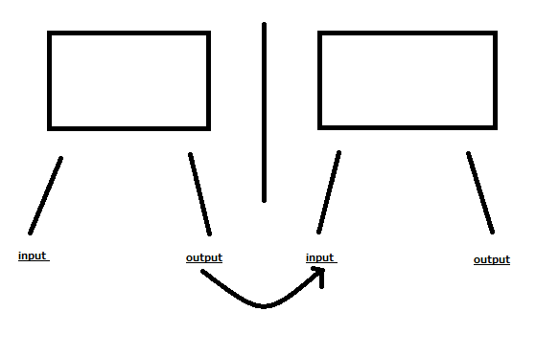
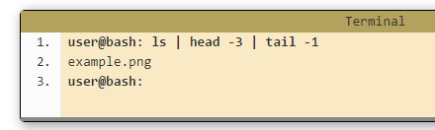
Basic Command
pipe
Pipe (|) operator feed the output from the program on the left as input to the program on the right. In the example below we will list only the first 3 files in the directory.
Type man ls for more info

Slide 25
Basic Command
touch
SYNOPSIS
touch [OPTION]... FILE...
Function: create a file immediately without editing and Update the access and modification times of each FILE to the current time.
http://www.computerhope.com/unix/utouch.htm

Slide 26
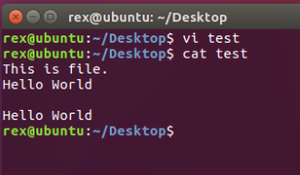
Basic Command
Vi
vim - Vi IMproved, a programmers text editor
SYNOPSIS
vim [options] [file ..]
Function: Vim is a text editor that is upwards compatible to Vi. It can be used to edit all kinds of plain text. It is especially useful for editing programs. It can also create a file.
I for insert (edit)
X for delete character under cursor
Dd for delete entrie line
V for highlight
Y for copy
P for paste
Insert (keyboard) for paste
:q for quit
:q! for quit without any troubles
:wq for write and quit (Save and quit)
:w for write (save)
http://www.computerhope.com/unix/uvi.htm

Slide 27
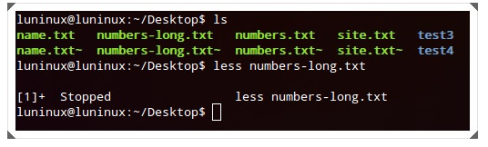
Basic Command
less
SYNOPSIS
less <file-name>
Function: prints the given file page by page (or window by window). It’s useful and efficient for viewing large files containing lots of textual data that won’t fit on the screen. You can press Ctrl+F to go forward and Ctrl+B to go backward by one page. It’s the same as you viewing the contents of a text file in a text viewer or editor and reading the file page by page in GUI.
http://www.computerhope.com/unix/uless.htm

Slide 28
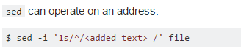
Basic Command
sed
sed - stream editor for filtering and transforming text
SYNOPSIS
sed [OPTION]... {script-only-if-no-other-script} [input-file]...
http://www.computerhope.com/unix/used.htm

Slide 29
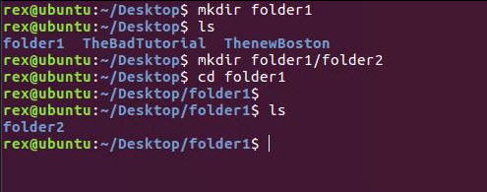
Basic Command
mkdir
SYNOPSIS
mkdir <new-directory-name>
Function: mkdir <new-directory-name> makes (or creates) a new directory. It’s the same as you using the context menu’s ‘new/create directory’ option to create a new folder (or directory) using file explorer in GUI.
http://www.computerhope.com/unix/umkdir.htm

Slide 30
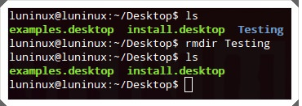
Basic Command
rm
SYNOPSIS
rm <file-name>
Function: removes the given file or folder.
http://www.computerhope.com/unix/urm.htm

Slide 31
Basic Command
rmdir
SYNOPSIS
rmdir <directory-name>
Function: remove empty directory. (It can not remove non-empty directory !)
http://www.computerhope.com/unix/urmdir.htm

Slide 32
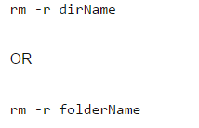

Basic Command
Remove non-empty folder
rm [OPTION]... FILE...
rm –r : Remove non-empty folder recursively
rm –rf : force to remove hidden files in a non-empty folder recursively
http://www.computerhope.com/unix/urm.htm
Type man ls for more info

Slide 33
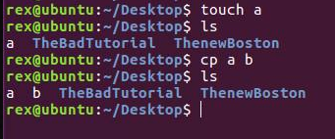
Basic Command
cp
SYNOPSIS
cp <source-file> <destination-file>
Function: To copy one or more files to another location..
http://www.computerhope.com/unix/ucp.htm

Slide 34
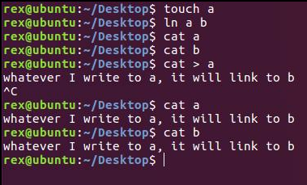
Basic Command
link
SYNOPSIS
link FILE1(exist) FILE2(non-exist)
ln FILE1(exist) FILE2(non-exist)
Function: call the link function to create a link to a file.
http://www.computerhope.com/unix/link.htm

Slide 35
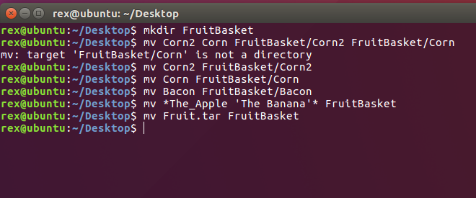
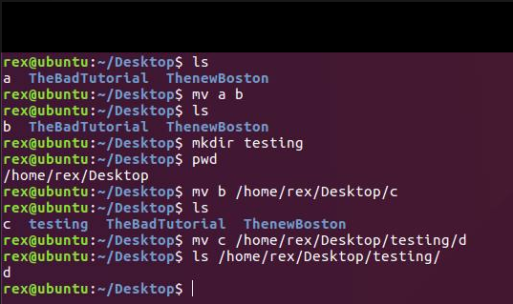
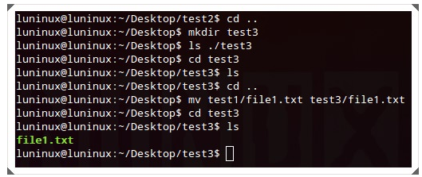
Basic Command
mv
mv- MoVe
SYNOPSIS
mv <source> <destination>
Function: move (rename) files
http://www.computerhope.com/unix/umv.htm

Slide 36
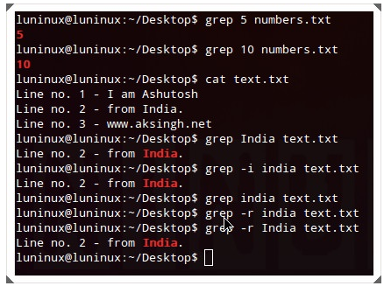
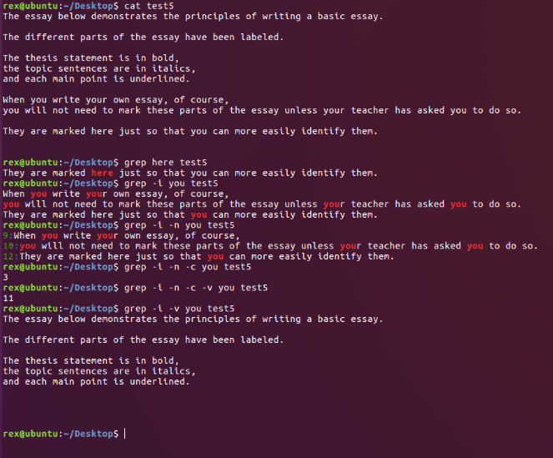
Basic Command
grep
SYNOPSIS
grep "<string>" <file-name>
Function: grep "<string>" <file-name> searches for a given string in a given file. You can use grep -i "<string>" <file-name> to make a case-insensitive search and grep -r "<string>" <file-name> to search for the given string in all files recursively in the current working directory.
http://www.computerhope.com/unix/ugrep.htm

Slide 37
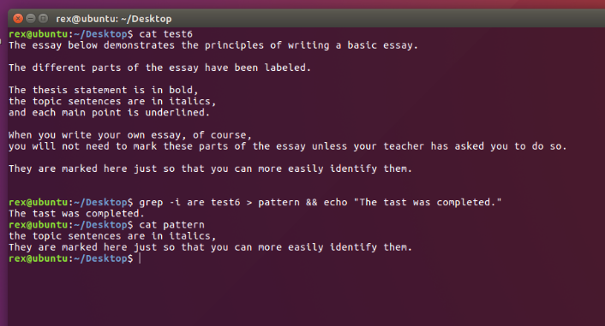
Basic Command
Grep with other tasks
http://www.computerhope.com/unix/ugrep.htm

Slide 38
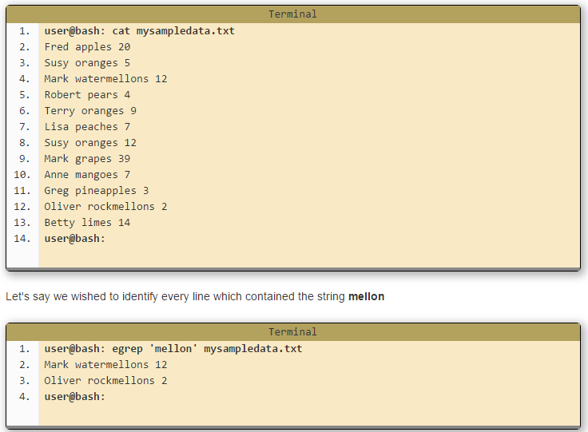
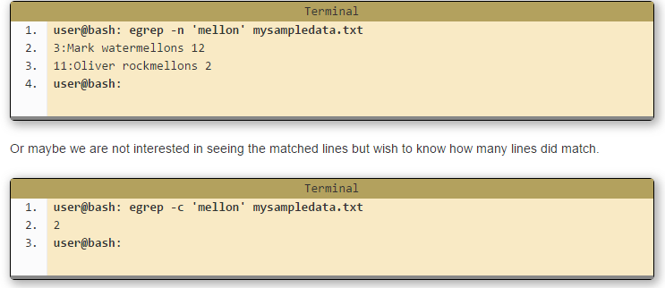
Basic Command
egrep
SYNOPSIS
egrep [command line options] <pattern> [path]
Function: View lines of data which match a particular pattern.
http://www.computerhope.com/unix/uegrep.htm

Slide 39
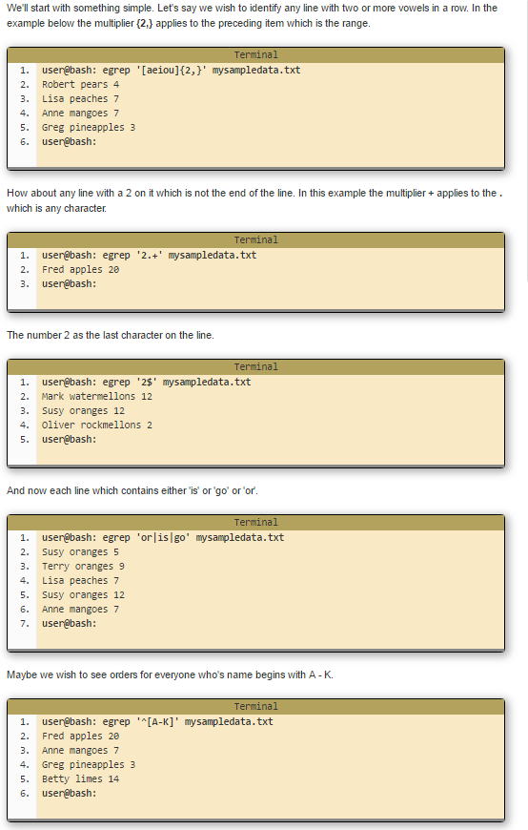
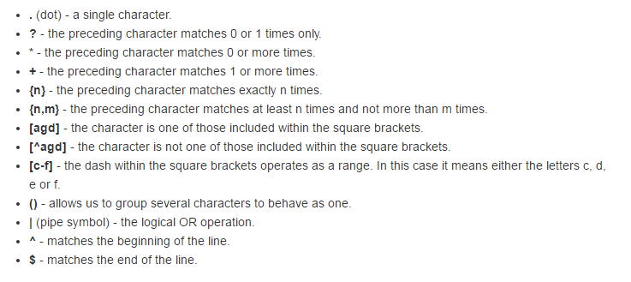
Basic Command
egrep
http://www.computerhope.com/unix/uegrep.htm

Slide 40
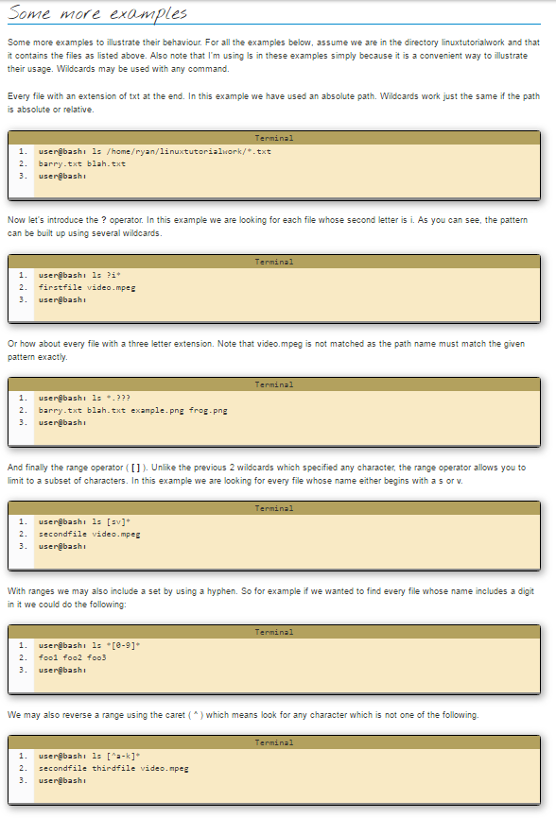
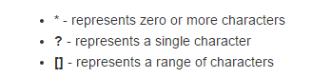
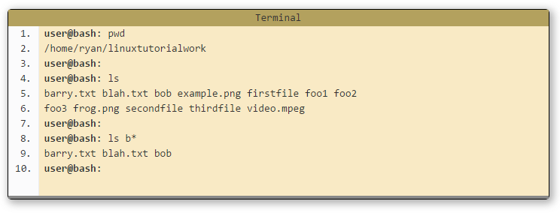
Basic Command
Wild card
http://ryanstutorials.net/linuxtutorial/wildcards.php

Slide 41
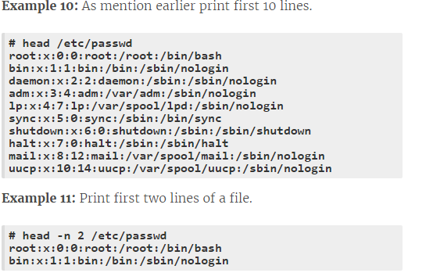
Basic Command
head
SYNOPSIS
head [OPTION]... [FILE]...
Functionprint the first 10 lines of the file.
http://www.computerhope.com/unix/uhead.htm

Slide 42

Basic Command
tail
SYNOPSIS
Tail [OPTION]... [FILE]...
Function: prints the last 10 lines (by default) of the given file on the standard output (i.e., the computer’s screen or monitor). You can use tail -n N <file-name> to dictate the last N number of lines to print on the screen..
http://www.computerhope.com/unix/utail.htm

Slide 43

Combine head and tail
http://www.computerhope.com/unix/uhead.htm
http://www.computerhope.com/unix/utail.htm

Slide 44

Basic Command
diff
diff– differences
SYNOPSIS
diff [options] from-file to-file
Function: find differences between two files
http://www.computerhope.com/unix/udiff.htm

Slide 45


Basic Command
wc
wc– Word Count
SYNOPSIS
wc [OPTION]... [FILE]...
Function: print the number of newlines, words, and bytes (Char) in files.
http://www.computerhope.com/unix/uwc.htm

Slide 46

Basic Command
sort
SYNOPSIS
sort [OPTION]... [FILE]...
Function: sort lines of text files.
Sort
<something>
Ctrl+d for sorting
http://www.computerhope.com/unix/usort.htm

Slide 47

Basic Command
cut
SYNOPSIS
cut [OPTION]... [FILE]...
Function: To divide a file into several parts (columns).
http://www.computerhope.com/unix/ucut.htm

Slide 48

Tar (Compress)
Basic Command
SYNOPSIS
tar -cvf <archive-name.tar> <file1-OR-file2-OR-both-to-archive>
Function: This command creates, views and extracts tar archives. You can use tar -cvf <archive-name.tar>.
http://www.computerhope.com/unix/utar.htm

Slide 49

Tar (View)
Basic Command
SYNOPSIS
tar -tvf <archive-to-view.tar>
Function: tar -tvf <archive-to-view.tar> to view
http://www.computerhope.com/unix/utar.htm

Slide 50

Tar (Extract)
Basic Command
SYNOPSIS
tar -xvf <archive-to-extract.tar>
Function: tar -xvf <archive-to-extract.tar> to extract tar archives
http://www.computerhope.com/unix/utar.htm

Slide 51

Basic Command
gzip
pwd – Print Working Directory
SYNOPSIS
Gzip <filename.gz>
Function: gzip <filename> creates and extracts gzip archives. You can use its gzip -d <filename> to extract gzip archives.
http://www.computerhope.com/unix/uzcat.htm

Slide 52

Basic Command
unzip
SYNOPSIS
unzip <filename.zip>
Function: unzip <archive-to-extract.zip> unzips a given zip archive. You can use unzip -l <archive-to-extract.zip> to view the contents of the zip file without extracting it. It’s the same as you using an archive program to extract zip archives in GUI.
http://www.computerhope.com/unix/unzip.htm

Slide 53

Basic Command
compress
SYNOPSIS
compress <filename>
Function: compress a file to a zip
http://www.computerhope.com/unix/ucompres.htm

Slide 54
Basic Command
uncompress
SYNOPSIS
uncompress <filename.z>
Function: uncompress a file to a zip
http://www.computerhope.com/unix/uuncompr.htm

Slide 55

Basic Command
zcat
SYNOPSIS
zcat <filename.z>
Function: display a zipped file
http://www.computerhope.com/unix/uzcat.htm

Slide 56

Basic Command
dd
SYNOPSIS
dd [OPTION]
Function: Convert and copy a file, write disk headers, boot records, create a boot floppy. dd can make an exact clone of an (unmounted) disk, this will include all blank space so the output destination must be at least as large as the input..
http://www.computerhope.com/unix/dd.htm

Slide 57

Basic Command
Sh/bash
Bash can also use on java python
SYNOPSIS
bash [options] [file]
Sh [options] [file]
Function: Bash is an sh-compatible command language interpreter that executes commands read from the standard input or from a file. Bash also incorporates useful features from the Korn and Cshells (ksh and csh).Bash is intended to be a conformant implementation of the Shell and Utilities portion of the IEEE POSIX specification (IEEE Standard 1003.1). Bash can be configured to be POSIX-conformant by default.
http://www.computerhope.com/unix/ubash.htm
http://www.computerhope.com/unix/ush.htm

Slide 58

Basic Command
Multi commands by ;

Slide 59

Basic Command
whatis
whatis <command-name> shows a single-line description for the given command.
http://www.computerhope.com/unix/whatis.htm

Slide 60

Basic Command
clear
SYNOPSIS
clear
Function: clear the terminal screen.
http://www.computerhope.com/unix/uclear.htm

Slide 61

Basic Command
stat
SYNOPSIS
stat [OPTION] FILE...
Function: display file or file system status
http://www.computerhope.com/unix/stat.htm

Slide 62

Basic Command
netstat
The netstat command is used to printnetwork connections, routing tables,interface statistics, masquerade connections, and multicast memberships.
http://www.computerhope.com/unix/unetstat.htm

Slide 63

Basic Command
ipconfig
ifconfig is used to configure, or view the configuration of, a network interface.
http://www.computerhope.com/unix/uifconfi.htm

Slide 64

ping
Basic Command
ping <remote-host-address> pings a remote host (server) by sending ping packets. It can be used to check for network connectivity or the status (up and running or otherwise) of a server. It’s the same as you pinging a host using the network manager in GUI.
http://www.computerhope.com/unix/uping.htm

Slide 65


Basic Command
Display disk space
du estimates and displays the disk space used by files.
http://www.computerhope.com/unix/udu.htm

Slide 66

Basic Command
banner
SYNOPSIS
banner [text]
Function: Print large bannner

Slide 67

Basic Command
install Software with APT apt-get
install - copy files and set attributes

Slide 68

exit
Basic Command
exit ends the current terminal (bash) session. It’s the same as you clicking on the close button in the title bar of any application to close that application in GUI.
http://www.computerhope.com/unix/uexit.htm

Slide 69
Basic Command
shutdown
The shutdown command brings the system down in a secure way. All logged-in users are notified that the system is going down, and login operations are blocked. It is possible to shut the system down immediately, or after a specified delay.
All processes are first notified that the system is going down by the signalSIGTERM. This gives programs like vi time to save the file being edited, mail andnews processing programs a chance to exit cleanly, etc.
shutdown does its job by signalling the init process, asking it to change therunlevel. Runlevel 0 is used to halt the system, runlevel 6 is used to reboot the system, and runlevel 1 is used to put the system into a state where administrative tasks can be performed (single-user mode). Runlevel 1 is the default, unless the -hor -r options are specified.
Shut down the system
http://www.computerhope.com/unix/ushutdow.htm

Slide 70
File Permission

Slide 71
File Permission
r read - you may view the contents of the file.
w write - you may change the contents of the file.
x execute - you may execute or run the file if it is a program or script.
- rwx r-x --x
owner - a single person who owns the file. (typically the person who created the file but ownership may be granted to some one else by certain users)
group - every file belongs to a single group.
others - everyone else who is not in the group or the owner.
File type
user
Group
other

Slide 72

File Permission
To change permissions on a file or directory we use a command called chmod It stands for change file mode bits which is a bit of a mouthfull but think of the mode bits as the permission indicators.
chmod [permissions] [path]
4 – read
2 – write
1 – execute
0-no permission
http://www.computerhope.com/unix/uchmod.htm

Slide 73
Shelling Scripting

Slide 74

Shelling Scripting
Execute multi commands in a file

Slide 75

Shelling Scripting
Read (input)

Slide 76

Shelling Scripting
Assign Variable in shell

Slide 77

Shelling Scripting
parameter

Slide 78

Shelling Scripting
Change permission using shell scripting

Slide 79

Shelling Scripting
Set to store parameter

Slide 80

Shelling Scripting
Use Set to store command

Slide 81


Shelling Scripting
Set parameter (2)

Slide 82

Shelling Scripting
Using script to change the file type

Slide 83

Shelling Scripting
$# Total parameter

Slide 84

Shelling Scripting
Use wildcard * to show total

Slide 85

Shelling Scripting
Expr and operators

Slide 86

Shelling Scripting
Operator with parenthesis

Slide 87


Bc(Basic Calculator) to calculate real number
Shelling Scripting
The Linux program bc can be used as a convenient desktop calculator. For interactive use you simply type "bc" at the command prompt in a terminal window and start typing arithmetic expressions.

Slide 88

Slash n for new line
Shelling Scripting

Slide 89

Shelling Scripting
Slash r for cut though line

Slide 90

Shelling Scripting
Slash r for cut though char

Slide 91

Shelling Scripting
Slash 033[1m for bold

Slide 92

Shelling Scripting
Slash 033[0m for non bold

Slide 93

Shelling Scripting
Slash 033[7m for highlight

Slide 94

Shelling Scripting
tput

Slide 95

Shelling Scripting
$? For error

Slide 96

Shelling Scripting
If-then

Slide 97

Shelling Scripting
If-then-else

Slide 98


Shelling Scripting
Compare operators
http://tldp.org/LDP/abs/html/comparison-ops.html

Slide 99

Shelling Scripting
Conditional operator
-b for video and image

Slide 100

Shelling Scripting
Check if file exist?

Slide 101

Shelling Scripting
Check if directories exist

Slide 102

Shelling Scripting
Check if it is empty file

Slide 103


Give and take permission
Shelling Scripting

Slide 104


Shelling Scripting
String Compare operator
True if length of the string is non zero
http://tldp.org/LDP/abs/html/comparison-ops.html

Slide 105

Shelling Scripting
And operator

Slide 106


Shelling Scripting
Using wc in if to check if it is a character
If there have new line, it will fail
Best version
This version for new line

Slide 107

Shelling Scripting
Check if it is vowel aeiou

Slide 108

Shelling Scripting
case

Slide 109

Shelling Scripting
Case to check char position

Slide 110

Shelling Scripting
while

Slide 111

Shelling Scripting
While vs until

Slide 112

Shelling Scripting
For to check directories in current directory

Slide 113

Shelling Scripting
For to check files in current directory

Slide 114

Shelling Scripting
For loop for directories and files

Slide 115

Shelling Scripting
Check errors

Slide 116

Shelling Scripting
Use grep in shell to display user info

Slide 117

Shelling Scripting
Use while to read each line from file

Slide 118

Shelling Scripting
sleep

Slide 119

Shelling Scripting
Count word and line without using wc

Slide 120

Shelling Scripting
Use while to show pattern

Slide 121

Shelling Scripting
break

Slide 122

Shelling Scripting
&&

Slide 123

Shelling Scripting
Loop with continue

Slide 124

Shelling Scripting
Check existing user with shell script

Slide 125

Shelling Scripting
Display help on command with shell script

Slide 126

Shelling Scripting
function

Slide 127

Shelling Scripting
Script nesting

Slide 128
User Account Management

Slide 129

User Account Management
Command sudo
sudo allows a permitted user to execute a command as the superuser or another user, as specified in the sudoers file.
http://www.computerhope.com/unix/sudo.htm

Slide 130

User Account Management
Command useradd & set password
http://www.computerhope.com/unix/useradd.htm

Slide 131

User Account Management
Command adduser
http://www.computerhope.com/unix/adduser.htm

Slide 132

User Account Management
Communicate with other users
http://www.computerhope.com/unix/write.htm

Slide 133

User Account Management
Command groupadd & usermod
http://www.computerhope.com/unix/usermod.htm
http://www.computerhope.com/unix/groupadd.htm

Slide 134

User Account Management
Command userdel
http://www.computerhope.com/unix/userdel.htm

Slide 135

User Account Management
List group

Slide 136
User Account Management
Switch user

Slide 137




User Account Management
List All Users In The System
/etc/passwd file contains one line for each user account, with seven fields delimited by colons. This is a text file.
You can easily list users using the cat command as follows:

Slide 138

User Account Management
W, who, whoami
w - Show who is logged on and what they are doing.
who - show who is logged on
whoami - print effective userid
http://www.computerhope.com/unix/whoami.htm
http://www.computerhope.com/unix/uwho.htm
http://www.computerhope.com/unix/w.htm

Slide 139
Setup and Connect to SSH

Slide 140

Setup and Connect to SSH
Find a server

Slide 141

Setup and Connect to SSH
Your main acc page

Slide 142




Setup and Connect to SSH
Setup a host

Slide 143

Setup and Connect to SSH
Receive a email with ip address

Slide 144

Setup and Connect to SSH
Root your ip address

Slide 145


Setup and Connect to SSH
Change password

Slide 146



Setup and Connect to SSH
Login to your ip address without password
Now you can login without password

Slide 147



Setup and Connect to SSH
Disable password

Slide 148

Setup and Connect to SSH
Set your server

Slide 149


Setup and Connect to SSH
Sftp and go to your server directory
http://www.computerhope.com/unix/sftp.htm

Slide 150


Setup and Connect to SSH
Set your homepage

Slide 151


Setup and Connect to SSH
Add directory to server

Slide 152

Setup and Connect to SSH
Download file from server to local

Slide 153

Setup and Connect to SSH
Download everything from server to local

Slide 154
Process File System Monitoring

Slide 155

htop
Process File System Monitoring
Basic info
PID The process ID.
USER The username of the process owner, or the user ID if the name can't be determined.
PRIORITY (PRI) The kernels internal priority for the process, usually just it‘s nice value plus twenty. Different for real-time processes.
NICE (NI) The nice value of a process, from 19 (low priority) to -20 (highpriority). A high value means the process is being nice, letting others have a higher relative priority. Only root can lower the value.
M_SHARE (SHR) The size of the process's shared pages
STATE (S)
The state of the process:
S for sleeping (idle)
R for running
D for disk sleep (uninterruptible)
Z for zombie (waiting for parent to read it's exit status)
T for traced or suspended (e.g by SIGTSTP)
W for paging
PERCENT_CPU (CPU%)
The percentage of the CPU time that the process is currently
using.
PERCENT_MEM
The percentage of memory the process is currently using (based on
the process's resident memory size, see M_RESIDENT below).
TIME (TIME+)
The time, measured in clock ticks that the process has spent in
user and system time (see UTIME, STIME above).
Command
The full command line of the process (i.e program name and
arguments).
http://manpages.ubuntu.com/manpages/precise/man1/htop.1.html

Slide 156

Process File System Monitoring
singal
http://www.computerhope.com/unix/signals.htm

Slide 157

Process File System Monitoring
Kill process
http://www.computerhope.com/unix/ukill.htm

Slide 158


Process File System Monitoring
Disk space Free
df – Disk space Free
SYNOPSIS
df [OPTION]... [FILE]...
df - report file system disk space usage
df shows information about the file system’s disk space usages – used and available storage space on your hard disk and other storage devices. You can use df -h to view the space usages in human readable form (i.e. memory in GBs).
http://www.computerhope.com/unix/udf.htm

Slide 159


Process File System Monitoring
proc
proc is very special in that it is also a virtual filesystem. It's sometimes referred to as a process information pseudo-file system. It doesn't contain 'real' files but runtime system information (e.g. system memory, devices mounted, hardware configuration, etc). For this reason it can be regarded as a control and information centre for the kernel. In fact, quite a lot of system utilities are simply calls to files in this directory. For example, 'lsmod' is the same as 'cat /proc/modules' while 'lspci' is a synonym for 'cat /proc/pci'. By altering files located in this directory you can even read/change kernel parameters (sysctl) while the system is running.

Slide 160

Process File System Monitoring
ProcesseS
ps displays information about the running processes of the system.
http://www.computerhope.com/unix/ups.htm

Slide 161


Process File System Monitoring
Important directories
http://tldp.org/LDP/abs/html/systemdirs.html

Slide 162

Process File System Monitoring
Important directories
http://www.tecmint.com/linux-directory-structure-and-important-files-paths-explained/

Slide 163

Process File System Monitoring
partition

Slide 164

Process File System Monitoring
Free memory
free – Free memory
free shows information about the free, used, swap memory available (or currently free) in your system. You can use free -m to view memory in KBs and free â€“g to view memory in GBs.
http://www.computerhope.com/unix/free.htm

Slide 165

Process File System Monitoring
jobs
Lists the status of all running jobs.
http://www.computerhope.com/unix/ujobs.htm

Slide 166


Process File System Monitoring
Find out working directory for a process

Slide 167
Helpers

Slide 168

man
Helpers
man – Manual
man - format and display the on-line manual pages
http://www.computerhope.com/unix/uman.htm

Slide 169

help
Helpers
<command-name> --help lists all the available commands in the terminal. You can use ‘-h’ or ‘–help’ (help has two hyphens here) option with any command to get help for that specific command.
http://www.computerhope.com/unix/uhelp.htm

Slide 170

info
Helpers
info - read Info documents
SYNOPSIS
info [OPTION]... [MENU-ITEM...]
http://www.computerhope.com/unix/info.htm

Slide 171
END

